Slide 1

Tableau Project on Walmart Retail Dataset
Created By :
Miss. Anjali C. Tapase

Slide 2
Problem Statements
State Wise information
Region Wise Information
Customer Information
Product Sub-Category Information
Weekly sales on the basis of Shipping Date
Daily sales on the basis Order Date
Source of Data :
. http://www.kaggle.com/dataset

Slide 3
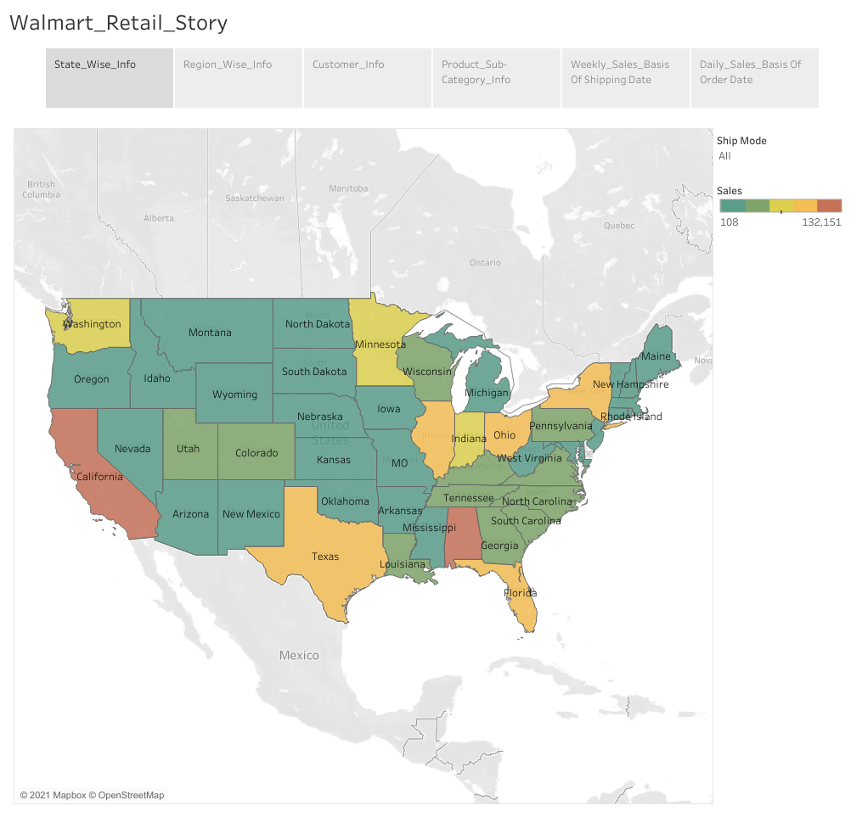

Slide 4
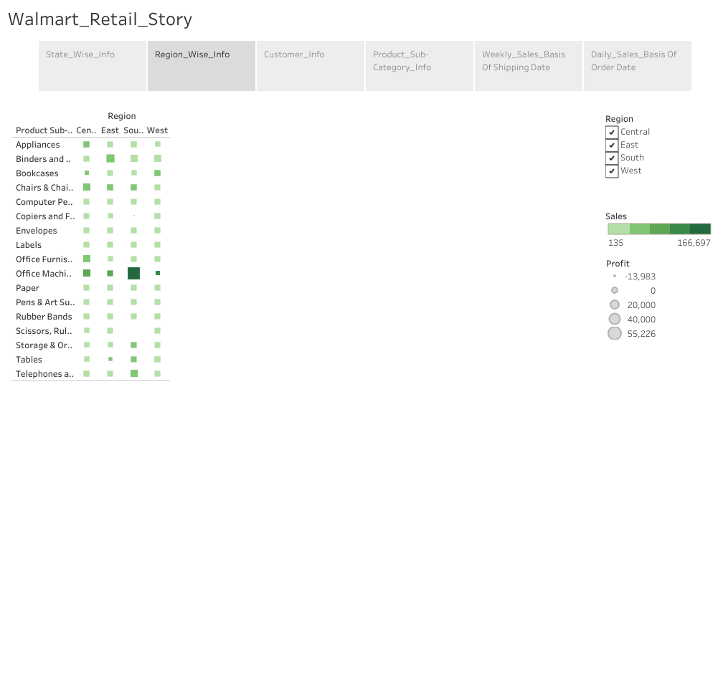

Slide 5
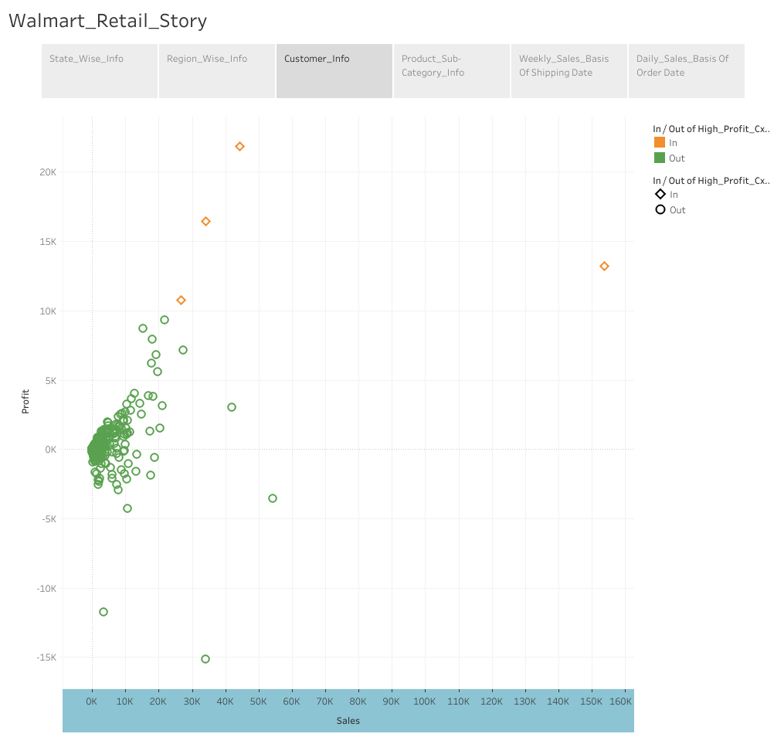

Slide 6
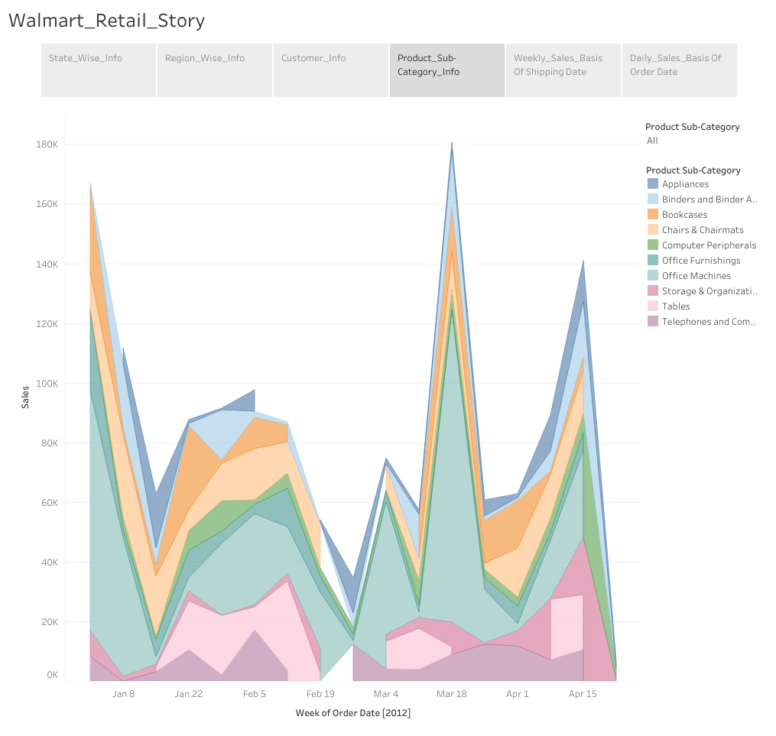

Slide 7
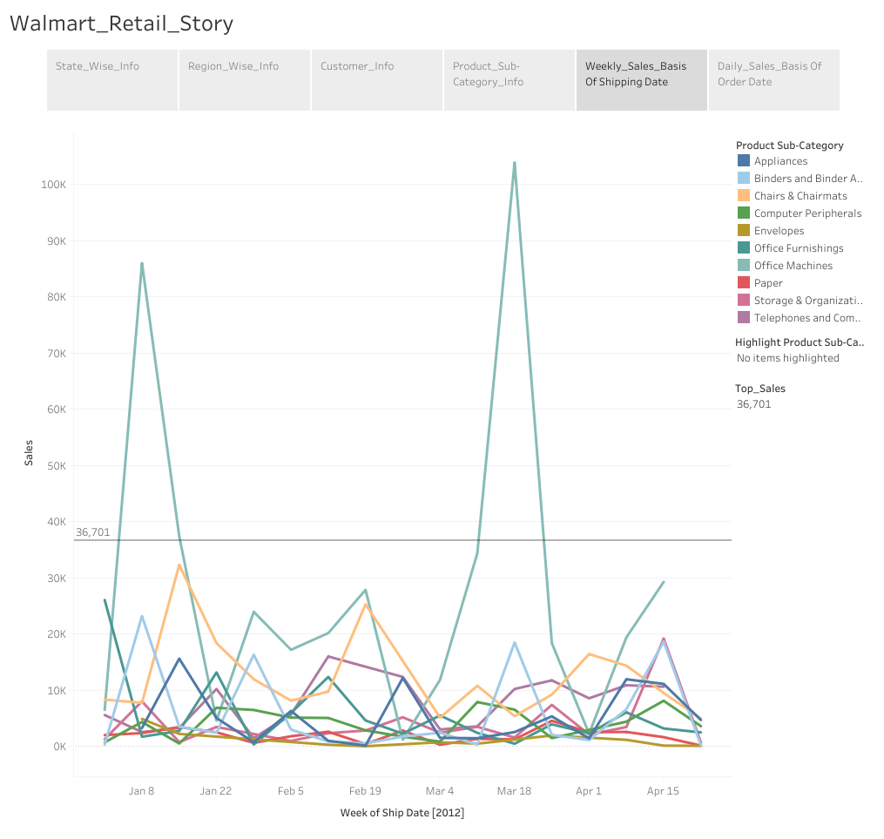

Slide 8
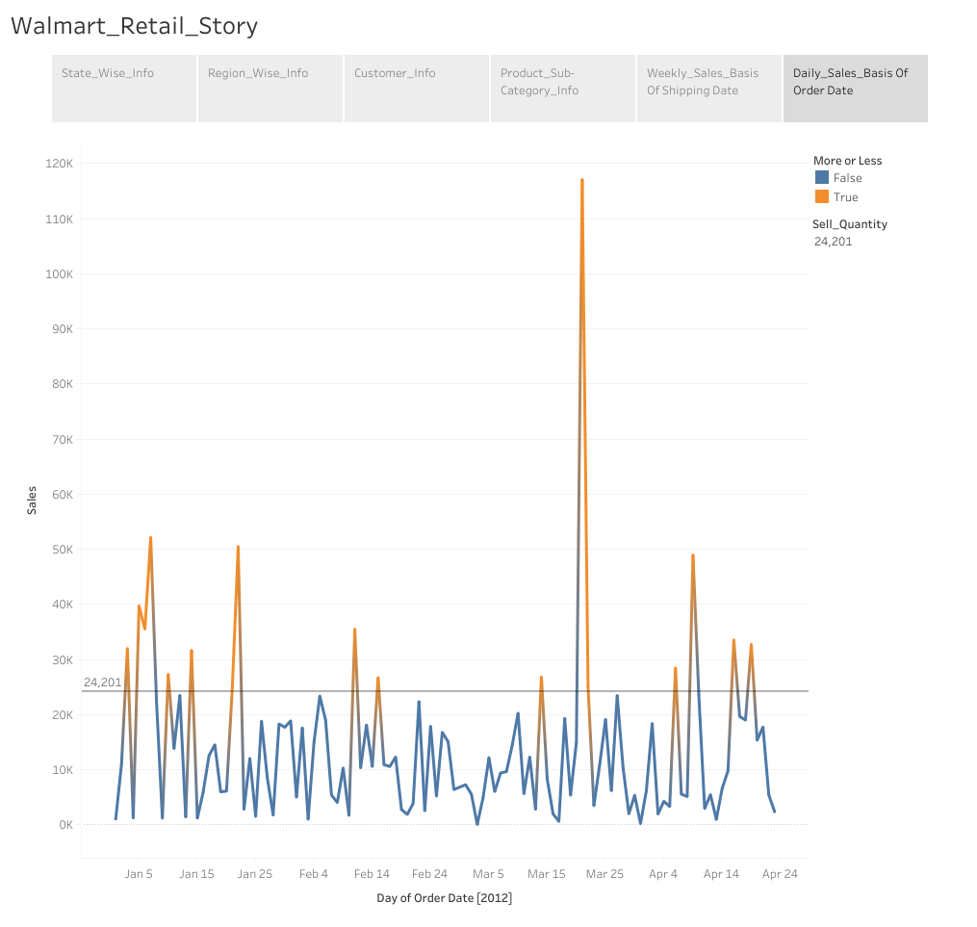

Slide 9
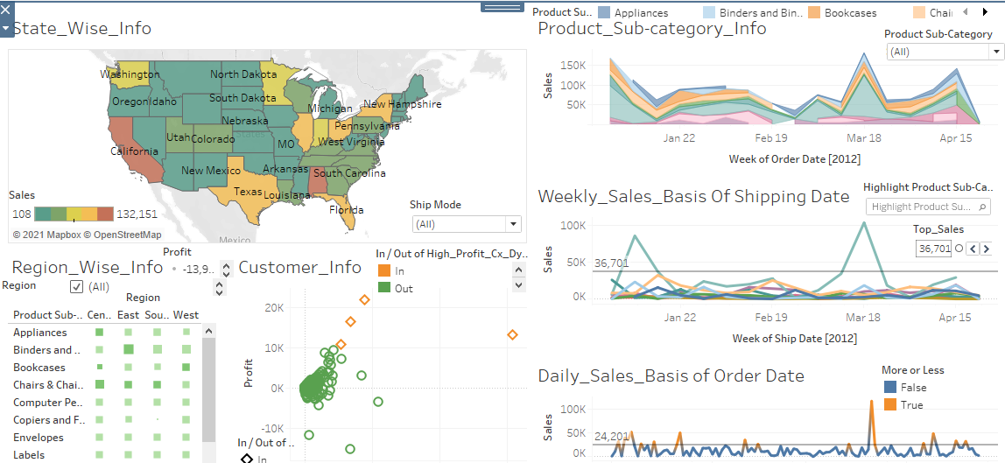
Dashboard of Walmart Retail Dataset

Slide 10
Tableau Public Link
https://public.tableau.com/app/profile/anjali.mude/viz/TableauProjectonWalmartRetailDataset/Walmart_Retail_Dashboard?publish=yes
https://public.tableau.com/app/profile/anjali.mude/viz/TableauProjectonWalmartRetailDataset/Walmart_Retail_Story?publish=yes
Google Drive Link For Walmart Retail Dataset
https://drive.google.com/drive/folders/1dVH7Y8jEd3xNvcRDt6pZ1nBsznFAlqFC?usp=sharing

Slide 11


